Slide 1
Server-client priority-based file sharing model using Fibonacci Heap
Done by:
106119038 – Girish Kumar MP
106119080 – M Shriram

Slide 2
Project description
Our project is based a client-server file-sharing model. Here, the clients, on connecting with the server, share a unique key, which would have a predefined priority on the server side. The server then sends the file to the clients on the basis of this priority. A Fibonacci heap is used to maintain the priorities as multiple clients keep connecting with the server.

Slide 3
Demo

Slide 4
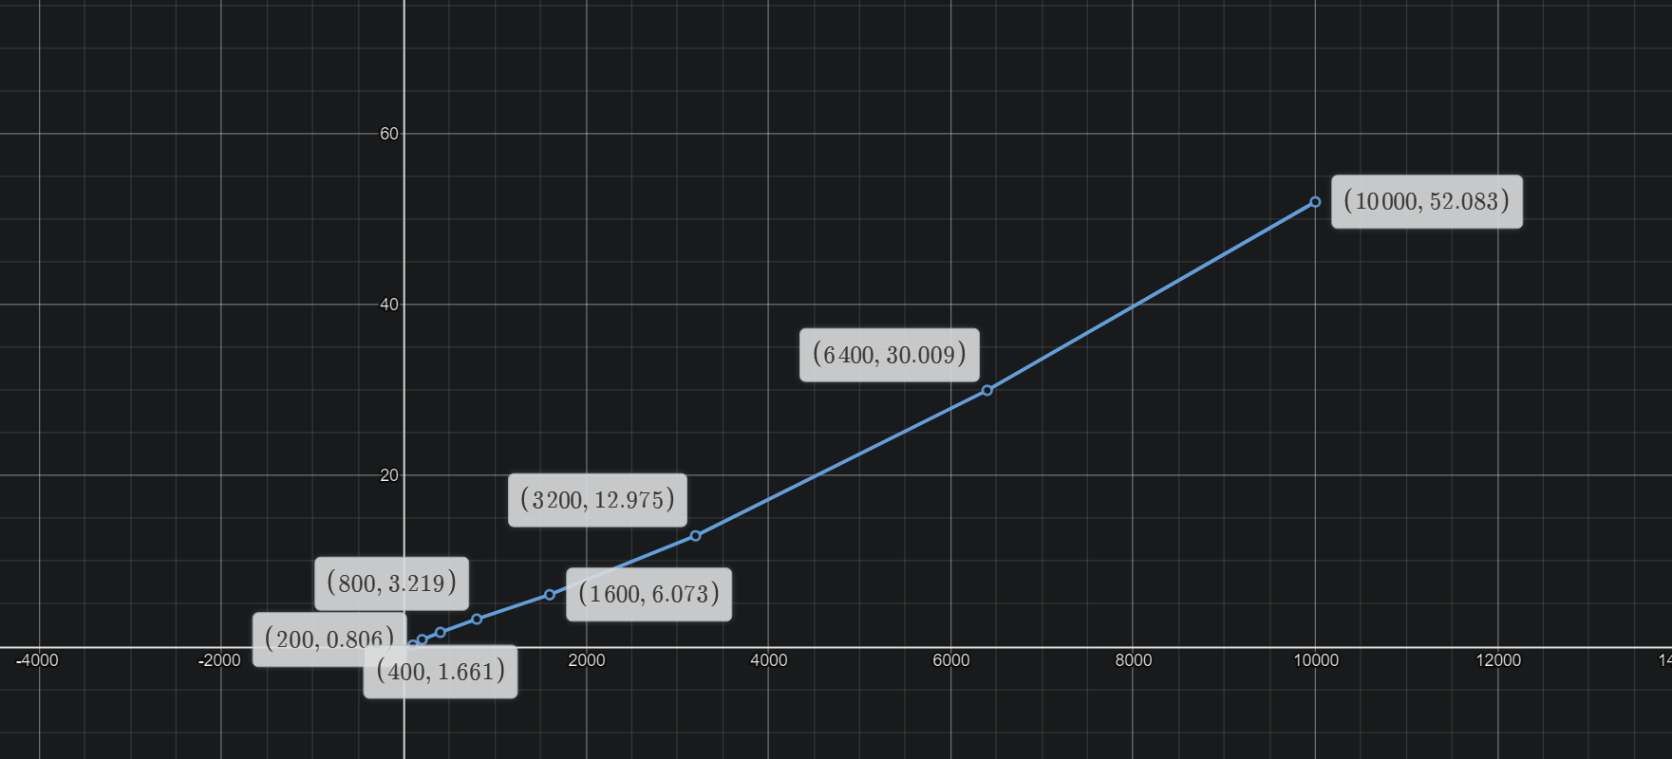
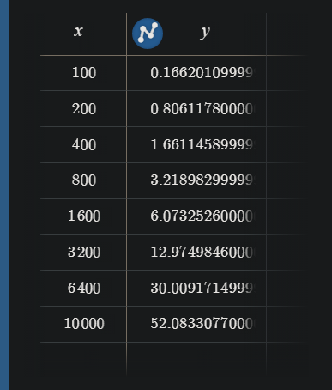
No of clients vs total time taken
X = no of clients
Y = Total time taken (seconds)

Slide 5
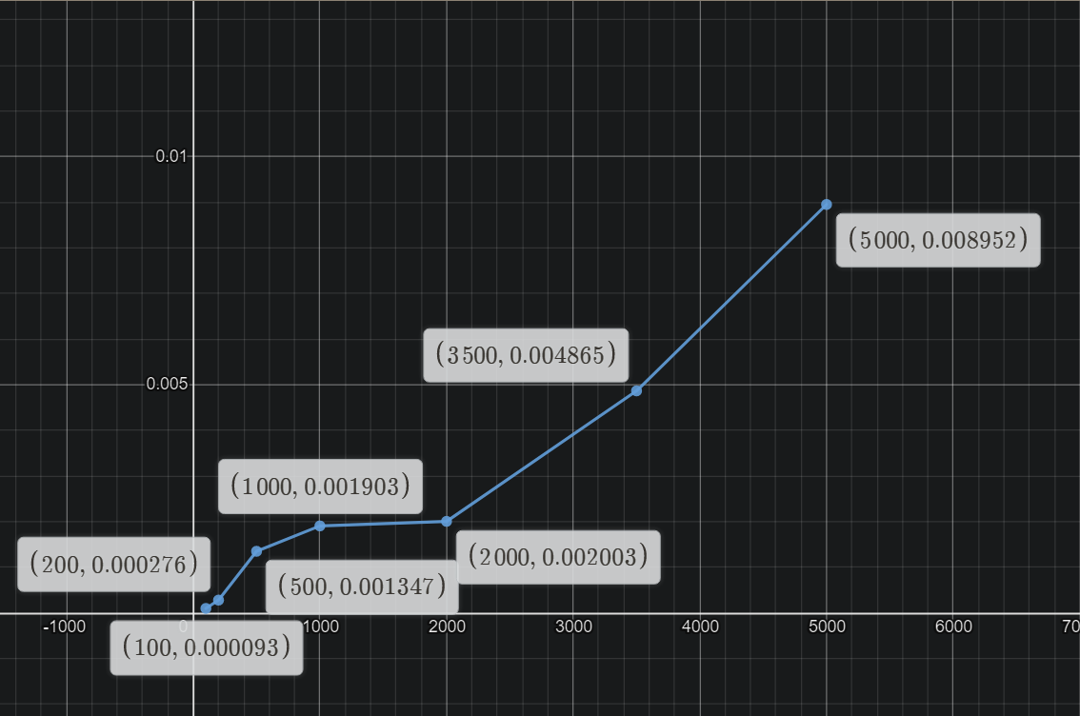
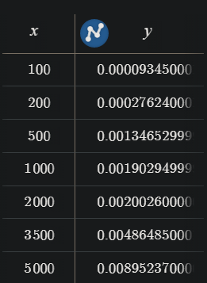
Average latency vs file size
X = File size (kb)
Y = Average Latency (seconds)

